Slide 1



Paper ID: 58, Paper Title: Health Care Management System Using Time Series Analysis
Presented by: Shubhangu Shukla
Full Affiliation: Student
Presentation Date: 21/11/2019

Slide 2
Table of Content
Introduction
Related Works
Proposed Model/Work
Methodology
Experimental Setup
Result Analysis
Conclusion
Future Scope
References

Slide 3
Introduction
The paper proposes a technique for risk prediction with graph-based proofs so as to observe and monitor the progress of a developing situation in the field of health.
Making an automated system which will help to predict various health parameters of a host remotely is our primary objective. Providing a way to predict the future body temperature, pulse rate, haemoglobin, systolic and diastolic pressure with the help of an existing data set record, in an optimized manner is our primary concern using which we can forecast the health of a patient.
Using the collected data with the help of a built-in framework to detect future health hazards is our main objective.
Forecasting the health condition is being done by using Time series algorithm to predict body temperature, pulse rate, haemoglobin, systolic and diastolic pressure of the host patient, in an efficient manner. The errors generated for the forecast values are compared using various error evaluation techniques.

Slide 4
Related Works
In the study of Using time series analysis to forecast emergency patient arrivals in CT department by Li Luo and Yabing Feng [2], the paper studies the occupational data of CT department which is based on the extensive data accumulated by CT department in West China Hospital of Sichuan University. Using two approaches, the data is being collected: on an hourly basis, and on a daily basis, and a forecast of the quantity in the immediate prospect which sets as a model is depicted in this paper. The design collected in this paper can be used for hospital managers to manage the allotment of patients and make acceptable allotment of medical resources efficiently because of the authenticity of the data and time series analysis of S.A.S. software is extensively implemented.
In the study of Application of Uni-variate Forecast- ing Models of Tuberculosis Cases in Kelantan by Sarimah Abdullah, Napisah Sapii, Sharina Dir and Tg Mardhiah Tg Jalal [4] the best time series model of TB cases from 2003 to 2010 in Kelantan and to anticipate the count of Tuberculosis incidents for the following 2 years, the analysis is devised to ascertain the pattern. An inspection using catalogued incidents which was briefed to the Kelantan Department of Health was conducted. All the examination and in- corporation in the series data as monthly data were catalogued for Tuberculosis cases from 2003 to 2010. In order to figure out the perfect forecasting design for the data series uni-variate modeling (Naïve Technique, Average Forecast, Exponential Smooth- ing Method, and Box-Jenkins Technique) has been practiced to the data series. Conclusion: Growth in trend pattern was noted based on 72 monthly data series of Tuberculosis incidents; also an increase in progression pattern was documented. The best time series model was found to be Double Exponential Smoothing technique when compared to Single Exponential Smoothing, Holts Technique, ARRES, and Holt Winters Trend and Seasonality for both multiplicative and additive hypothesis.

Slide 5
Proposed Work
A time series is a set of observations on the values that a variable takes at different times.
Such data may be collected at regular time intervals, such as monthly (e.g. CPI), weekly (e.g. Money supply), quarterly (e.g. GDP), or annually (e.g. Government Budget).
Time series are used in statistics, econometrics, mathematical finance, weather forecasting , earthquake prediction and many other applications.
The anticipation of future values based on the beforehand observed values is the usage of time series analysis. Business prediction involves time series analysis. A lot of traders can be seen investing in the Sensex who are trying to predict the future of the market the forthcoming day. A number of retailers try to see the number of goods they are going to sell the next day. All of it can be achieved with time series analysis.
Time series is not only limited to only retail and finance, but it is applicable everywhere. In this way, we can analyze when the market just went up or has a dip, which can help to analyze the past data, and predict future data.
There are generally two types of time series analysis:
1) Uni-variate Time Series 2) Multi-variate Time Series

Slide 6
Uni-Variate Time Series- A uni-variate time series consists of single observations that are recorded over regular time intervals.
Multi-Variate Time Series- is a type of data is collected by observing many subjects (such as individuals, firms, countries, or regions) at the same point of time or during the same time period.
In this paper implementation for the time series algorithm is being used by ”Univariate Time Series”.
Various patterns can be observed in the data set based on the interval of the recorded data set (hour, day, week, month, quarter, annual, etc) which forms the modeled component.
Trend- A trend is a long term relatively smooth pattern that usually persists for more than one year. A person may have a smooth pattern of health records which may be termed as trending.
Seasonal- A pattern that appears in a regular interval wherein the frequency of occurrence is within a year or even shorter. A person may show symptoms of frequent illness for certain health parameters then it is termed as seasonal.
Cyclic- The repeated pattern that appears in a time series analysis but beyond a frequency of one year. A person may show cyclic health disorders in a case of a severe health condition.

Slide 7
Limitations of Time Series Analysis-
Cases where values are constant, time series cannot be applied.
Values in the form of functions e.g. sin x, cos x, where values can be predicted by simply substituting different values of x in the mathematical function. So, there is no point of applying time series analysis, where values can be calculated just by using a function.

Slide 8
Methodology
Various approaches under time series forecasting to predict the future are as follows-
1) Past Average or Naïve Method:-
It refers to the past data arranged in chronological order as dependent variable and time as an independent variable. Past average is best for cyclic variation. In this method forecast for the next period is equal to the mean or average for the previous periods.
2) Exponential Smoothing:-
Exponential Smoothing is one of the more popular smoothing techniques due to its flexibility, ease in calculation, and good performance. This method requires only the current data values and the forecasted data values for the current period. It is distinguished by the fact that it assigns weights to all the previous data and the pattern of weights assigned are of exponential form. Most recent data is given more weightage and the weights assigned to older periods decreases exponentially.
S₀= x₀
S_{t} = αx_{t-1} + (1-α)st-1, t > 0
where
original observations are denoted by {x_{t}} starting at t = 0
α is the smoothing factor which lies between 0 and 1.

Slide 9
3) Moving Average Smoothing:-
In Moving Average Smoothing, each observation is assigned an equal weight, and each observation is forecasted by using the average of the previous observation(s). This smoothing technique predicts X_{t} + k as follows:
S_{t}= W_{t−1}*X_{t−1} + W_{t}−2*X_{t−2} + W_{t−3}*X_{t−3} + .......+ W_{t−n}*X_{t−n}
where,
W_{t−1}, W_{t−2}, W_{t−3},....W_{t−n} are the smoothing parameters such that W_{t−1} + W_{t−2} + W_{t−3} + .... + W_{t−n} = 1.
n = number of periods.
X_{t-1} = Actual values in period t-1.
The weights can be given random values to get the result but it will not give the correct the result. In order to forecast the correct result the following method is used:
Sum of digit method to calculate n-period:
Sum of n natural numbers = n(n+1)/2 = Σ n.
2) n/Σ n , (n−1)/Σ n , (n−2)/Σ n ,.......
For n=4 Σ n = 4(5)/2 =10 Hence W₁= 4/10 W₂= 3/10 W₃= 2/10 W₄= 1/10 .

Slide 10
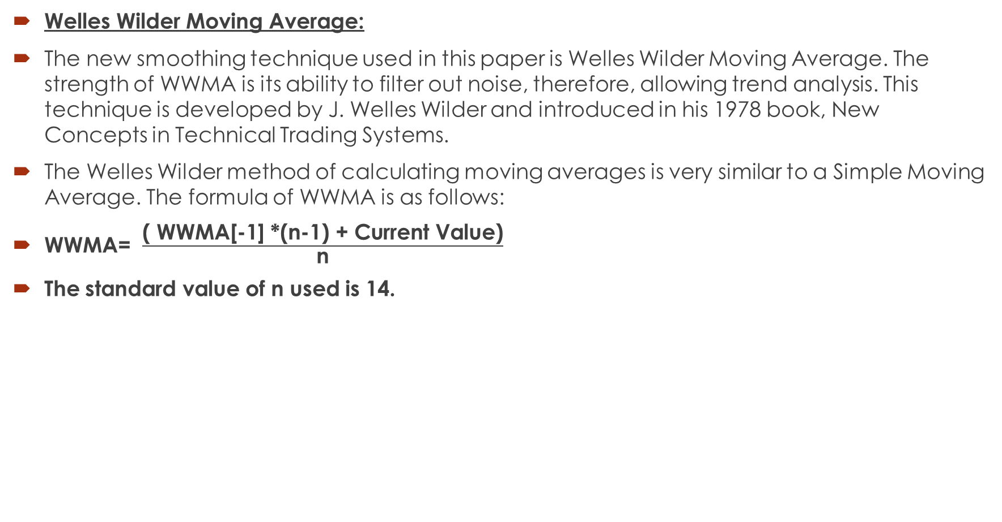
Experimental Setup
Welles Wilder Moving Average:
The new smoothing technique used in this paper is Welles Wilder Moving Average. The strength of WWMA is its ability to filter out noise, therefore, allowing trend analysis. This technique is developed by J. Welles Wilder and introduced in his 1978 book, New Concepts in Technical Trading Systems.
The Welles Wilder method of calculating moving averages is very similar to a Simple Moving Average. The formula of WWMA is as follows:
WWMA= $\frac{\text{( }\text{WWMA}\text{[−1] ∗(}\text{n}\text{−1) + }\text{Current} \text{Value}\text{)}}{\text{n}}$
The standard value of n used is 14.

Slide 11
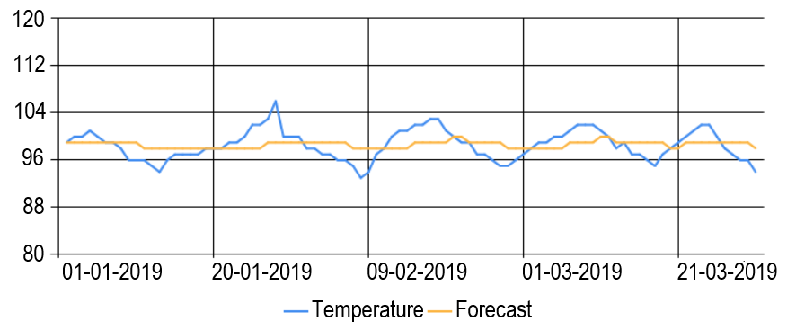
Data Set- The data set used for health predictions are based upon five parameters namely body temperature, pulse rate, haemoglobin levels, systolic and diastolic pressure. The data set is recorded on a daily basis for a time period of 3 months dated 1st January 2019 to 31st March 2019.
Retrieving Temperature Graph-

Slide 12
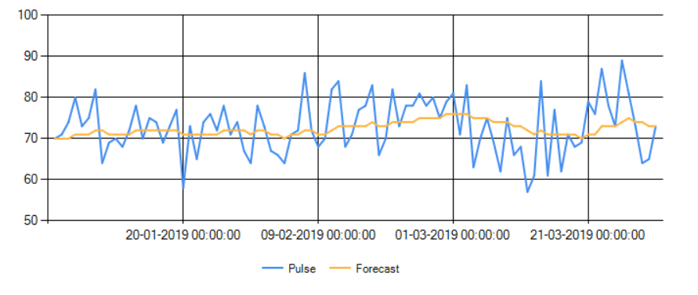
Retrieving Pulse Rate-

Slide 13
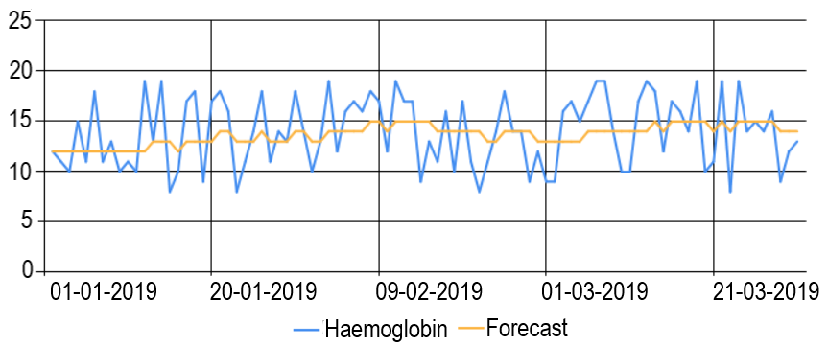
Retrieving Haemoglobin-

Slide 14
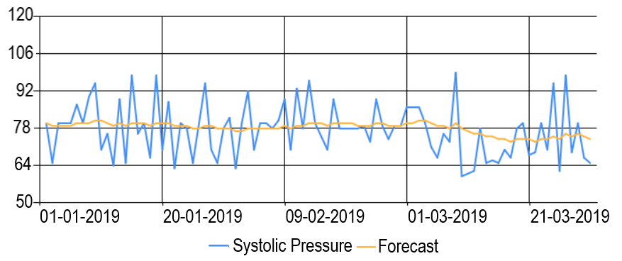
Retrieving Systolic Pressure-

Slide 15
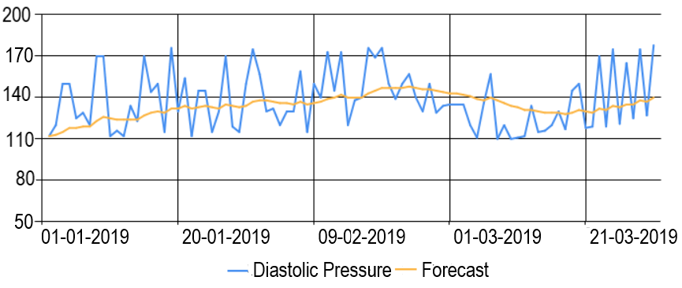
Retrieving Systolic Pressure-

Slide 16
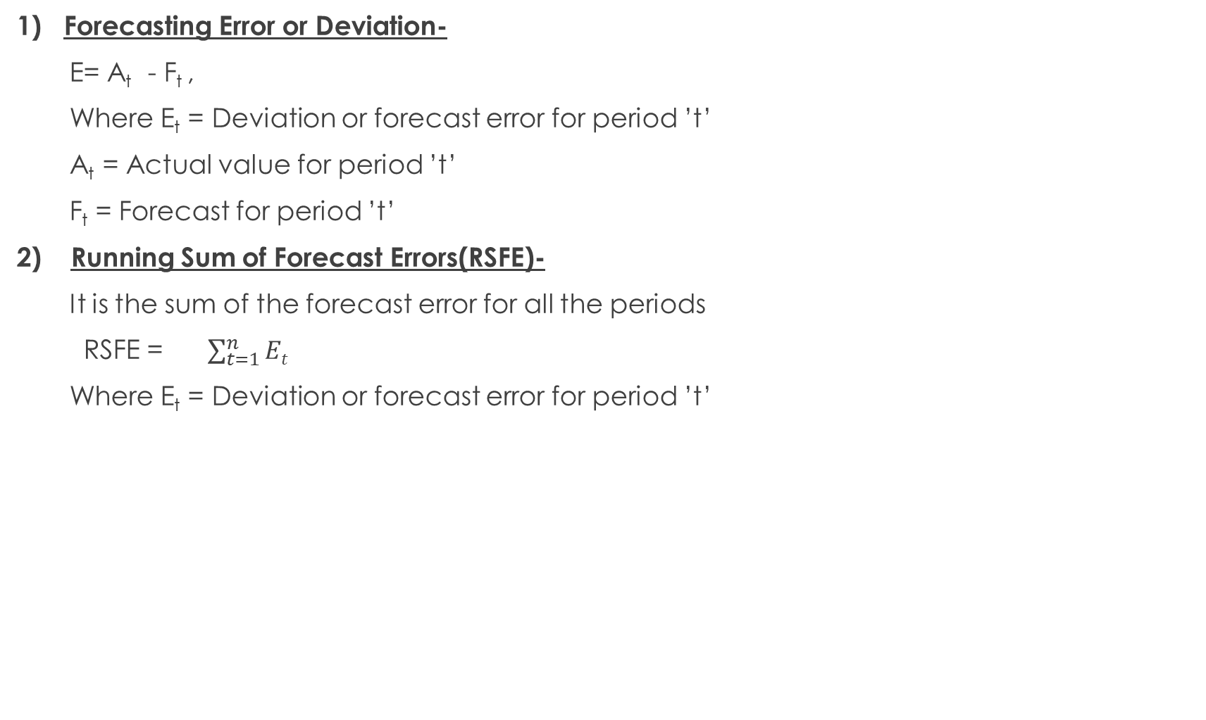
1) Forecasting Error or Deviation-
E= A_{t} - F_{t} ,
Where E_{t} = Deviation or forecast error for period ’t’
A_{t} = Actual value for period ’t’
F_{t} = Forecast for period ’t’
2) Running Sum of Forecast Errors(RSFE)-
It is the sum of the forecast error for all the periods
RSFE = $\sum_{t=1}^{n}{Et}$
Where E_{t} = Deviation or forecast error for period ’t’

Slide 17
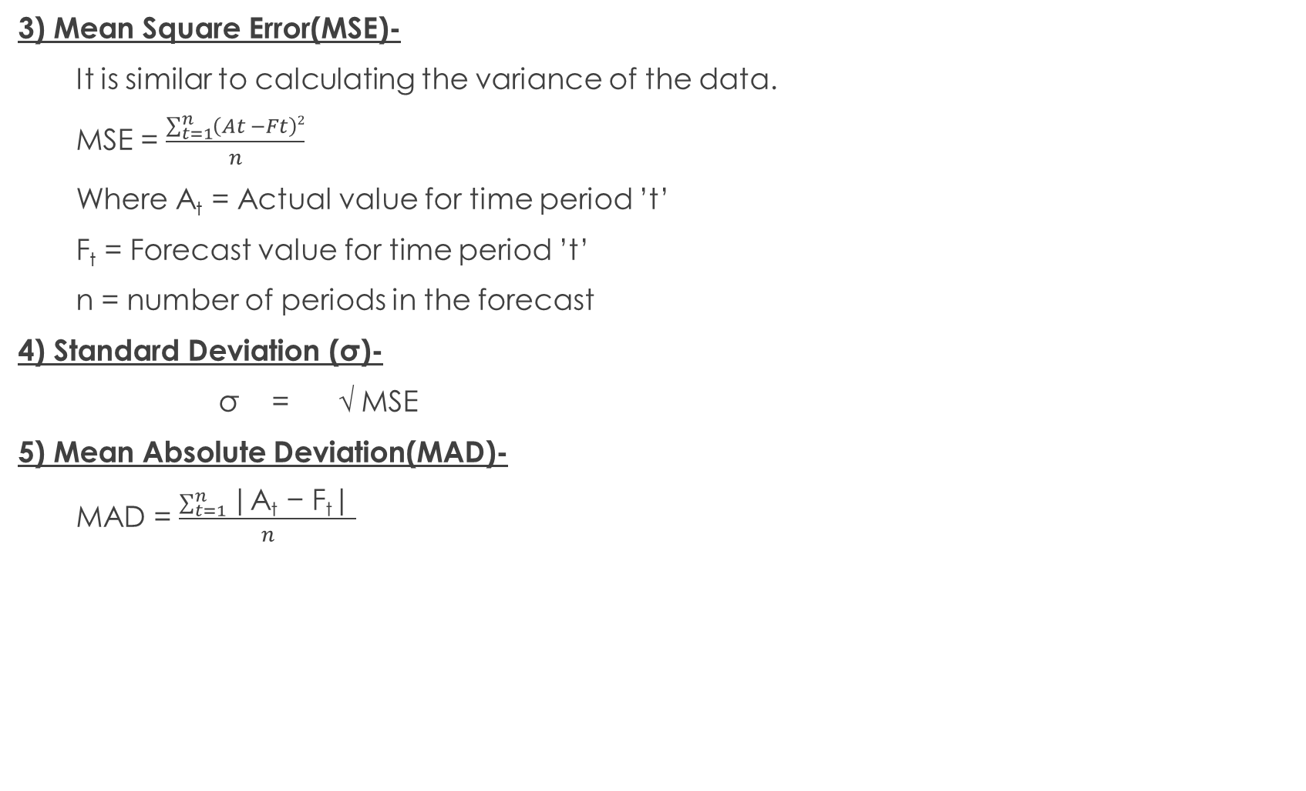
3) Mean Square Error(MSE)-
It is similar to calculating the variance of the data.
MSE = $\frac{\sum_{t=1}^{n}{\left(At −Ft\right)2}}{n}$
Where A_{t} = Actual value for time period ’t’
F_{t} = Forecast value for time period ’t’
n = number of periods in the forecast
4) Standard Deviation (σ)-
σ = √ MSE
5) Mean Absolute Deviation(MAD)-
MAD = $\frac{\sum_{t=1}^{n}{\text{|}\text{At}\text{ − }\text{Ft}\text{|}} }{n}$

Slide 18
Results
When this approach is applied for the entire dataset for the parameter ”Temperature” we get following error results:
RSFE (WWMA) = 3.26
RSFE (SWMA) = -7.33565
RSFE (NAIVE) = -1.693
where RSFE is Running Sum of Forecast Errors.
MSE(WWMA) = 11.52681401
MSE(SWMA) = 20.9658
MSE(NAIVE) = 24.35754
where MSE is Mean Square Error.
σ(WWMA) = 3.395116199
σ(SWMA) = 4.578842
σ(NAIVE) = 4.935336
Where σ is the Standard Deviation.

Slide 19
MAD(WWMA) = 2.895254524
MAD(SWMA) = 3.680538611
MAD(NAIVE) = 3.86767
where MAD is the Mean Absolute Deviation

Slide 20
Conclusion
The main objective in this research was to successfully forecast the various health parameters such as body temperature, pulse rate, haemoglobin, systolic and diastolic pressure of the host. There was a need to make a mark in the field of health sector using data mining as a tool. With the rise of data mining, an era of technology is moving towards a far superior dimension. The paper can definitely make a way for betterment in the field of health sciences. The research has been tested and implemented for a multiple number of times. The paper can be further extended with the help of superior software modules and new integration. Full and large scale implementation of the research can only help in realizing the full potential of the work.

Slide 21
Future Scope
The future scope of the research proposed is as follows:
1) The research can be considered as a platform for collecting the health record of patients which has been constrained to mainly body temperature, pulse rate, haemoglobin levels, systolic and diastolic pressure and can be further extended to various other health parameters like body weight, body mass index, pain, oxygen saturation, blood glucose level, blood platelets
count etc.
2) The research can be extended as an IOT project to develop an automated system which will help to monitor the host remotely.
3) The research can be used in disease prediction, disease classification and life expectancy prediction based upon classification techniques of data mining.
4) The research can be used in army services in an active situation.
5) It can provide a huge database for doctors to diagnose patients.

Slide 22
References
A. Baheti and D. Toshniwal, ”Trend Analysis of Time Series Data Using Data Mining Techniques,” 2014 IEEE International Congress on Big Data, Anchorage, AK, 2014, pp. 430-437.
Li Luo and Yabing Feng, ”Using time series analysis to forecast emergency patient arrivals in CT department,” 2015 12th International Conference on Service Systems and Service Management (ICSSSM), Guangzhou, 2015, pp. 1-5.
L. B. Amor, I. Lahyani and M. Jmaiel, ”Recursive and Rolling Windows for Medical Time Series Forecasting: A Comparative Study,” 2016 IEEE Intl Conference on Computational Science and Engineering (CSE) and IEEE Intl Conference on Embedded and Ubiquitous Computing (EUC) and 15th Intl Symposium on Distributed Computing and Applications for Business Engineering (DCABES), Paris, 2016, pp. 106-113.
S. Abdullah, N. Sapii, S. Dir and T. M. T. Jalal, ”Application of univariate forecasting models of tuberculosis cases in Kelantan,” 2012 International Conference on Statistics in Science, Business and Engineering (ICSSBE), Langkawi, 2012, pp. 1-7.
A. Fakhrazari and H. Vakilzadian, ”A survey on time series data mining,” 2017 IEEE International Conference on Electro Information Technology (EIT), Lincoln, NE, 2017, pp. 476-481.

Slide 23
Thank You

